Slide 1










Visual Stories That Shape Emotion
Bright Tv Entertainment
Presented By:
NOMPETHO NGOBENI

Slide 2
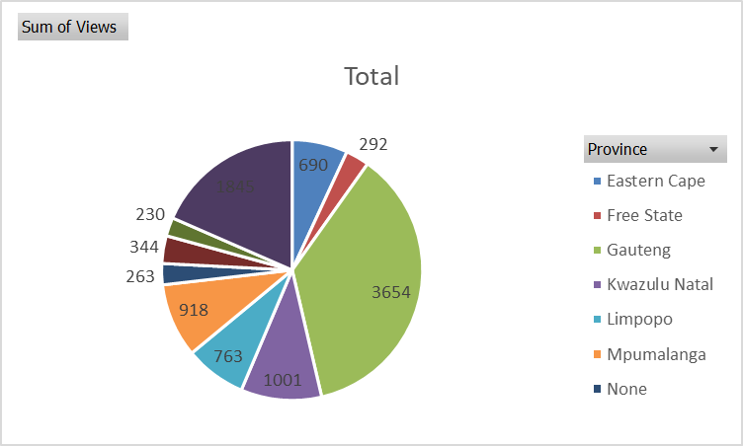
VIEWERSHIP SPLIT BY PROVINCE

Slide 3
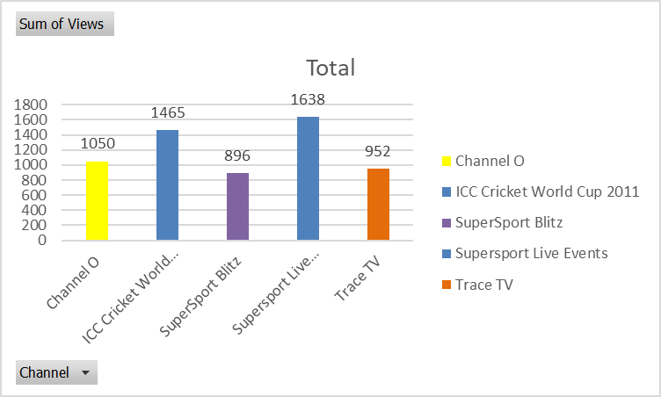
TOP 5 MOST WATCHED SHOWS

Slide 4
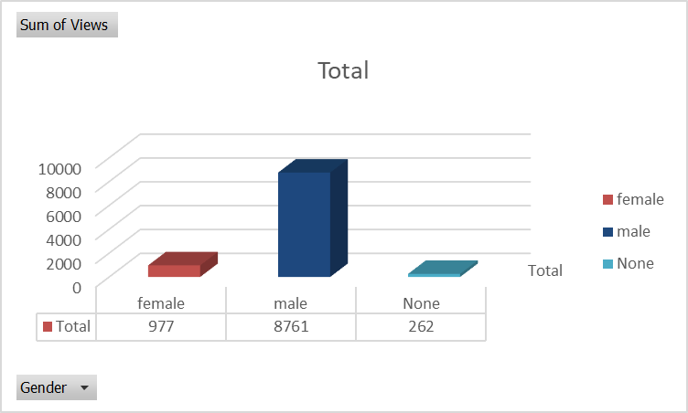
VIEWERSHIP SPLIT BY GENDER

Slide 5
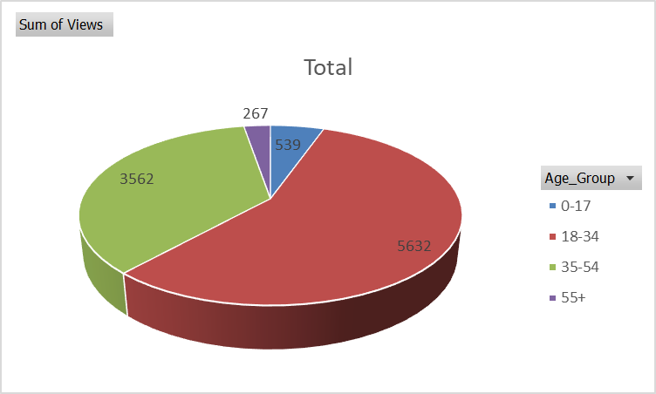
VIEWERSHIP BY AGE BUCKETS

Slide 6
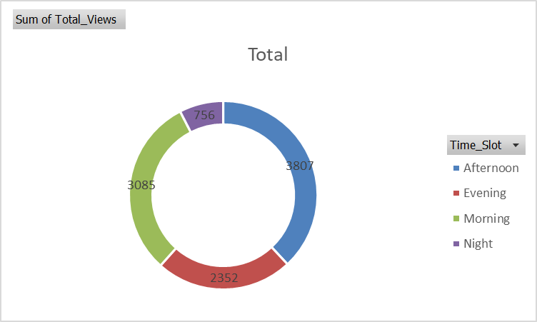
VIEWERSHIP SPLIT BY TIMESLOT

Slide 7
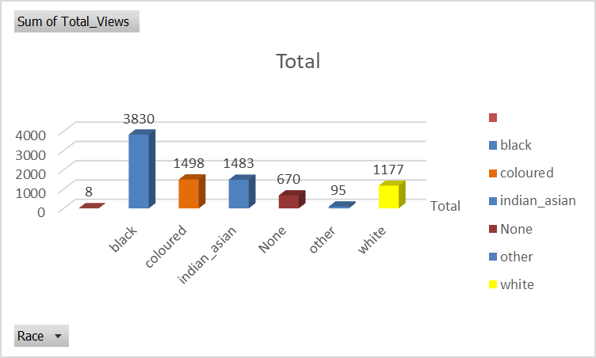
MALE VIEWERSHIP PROFILE

Slide 8



THANK YOU !!!
+123-456-7890
nompethotrecia@gmail.com

